Slide 1
Manual Testing
Software: Is a collection of computer programme
System S/w: OS (Windows, MAC, LINUX)
Windows +r ->winver
Programming : Complier and debugger (Command promote)
Application S/w: Web, mobile, Desktop
Software testing : its an activity to detect and identify the defect in the software.

Slide 2
Factors that state the Sw quality
Bug free
Delivered on time
Within budget
Maintainable (User friendly)
Meets the requirement/ Expectations
Project | Product
Specific customer | Multiple customers
Customer expectations | Market expectations
Tcs, cts | IBM ,google

Slide 3
Error: Human mistakes
Bug : Deviations from expected behaviour to actual behaviour
Ex: login (with valid UN and PW not able to login)
Failure: Deviations identified by end user while using system.
Ex : Very in test environment
Why S/W has bugs?
S.w complexity
Miscommunication
Programming error
Change in requirement
Lack of skilled testers

Slide 4
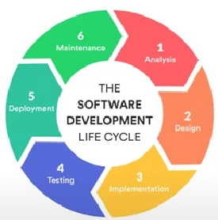
SDLC
Requirement Analysis
Design
Implementation
Testing
Development
Deployment
Maintenance

Slide 5
SDLC cont..
Requirement Analysis : it’s a phase where we collect all the needed requirement to crate a s/w
Design : Blueprint of s/w
Implementation : This phase indicates the start of Development
Testing : This phase carryout testing of complete project meeting as per requirement
Deployment : Indicates the deployment of s/w to real environment
Maintenance : Solving real-time issues

Slide 6
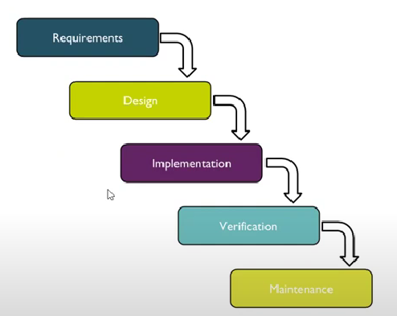
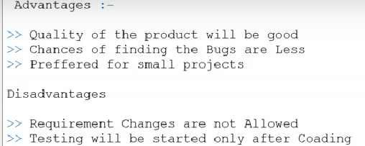
Waterfall Model

Slide 7
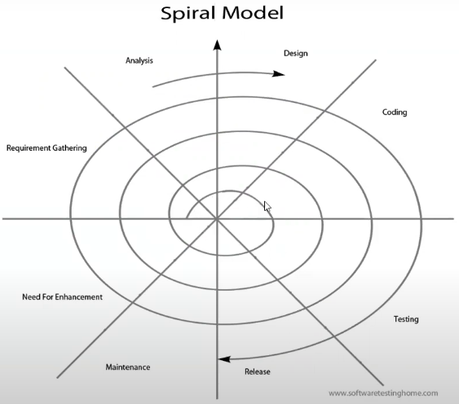
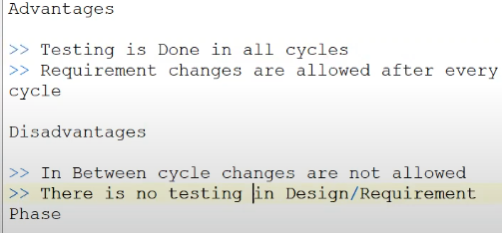
Spiral Model / Version control

Slide 8
Verification and validation
Verification - Static | Validation - Dynamic
Checks weather we are building right product | Checks whether we are building the product right
Focus on documentation | Focus on software
 | Once verification done validation will takes place.
Static Testing Technique: Review : Conducts on document ex: Requirement,design,testplan/ testcase Walkthrough: Overall checking (People involved) , its not planned, Inspection: Reader/ Writer

Slide 9
QA : Quality Assurance | QC: Quality Control
Process related | Actual testing of sw)
Focus on building the quality | Focus on testing the quality

Slide 10
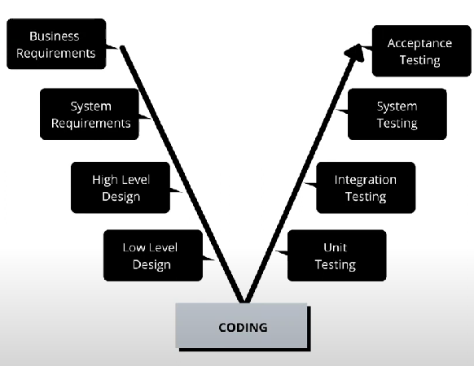
V and V
Black box testing
SRS document review
Whitebox testing

Slide 11
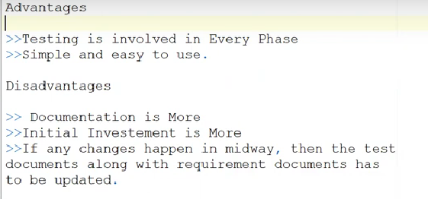
V & V cont..

Slide 12
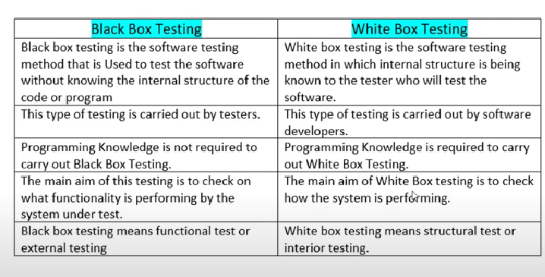
Black and White box

Slide 13
Regression and Retesting
Regression : Is a block box testing technique that consist of re-executing those tests are impacted by code changes
Types:
Unit regression: Testing only the changes/ modifications done by dev
Regional regression: Testing modified module along with impacted one
Impacted analysis meeting (QA/Dev)
Full Regression: Testing main feature and reaming part of app
Retesting: Testing the reported bugs which are fixed from developer [ ready for QA]
Tester close the bug if its worked otherwise re-open and send to developer
Same test again and again

Slide 14
Exploratory, Adhoc & Monkey/Gorilla
Informal way of testing
Exploratory | Adhoc | Monkey
No SRS will be provided | No SRS | No SRS
More time consuming | No Test case written | It will be done randomly
Bug cant be thought as a feature / Feature cant be thought as Bug | Tester should have knowledge on the application | Suitable for gamming application
All level of testing should be done

Slide 15
Smoke and Sanity testing
Smoking and Sanity testing will be done as soon we receive build from developer
Conduct both testing at same time but smoke test will done at initial level on critical functionality working or not and sanity testing will be done later stages to check main functionality working and bug fixes are tested
Smoke | Sanity
Performed to check Critical functionality Objective - verify build is stable/not | To check new functionality/bug have been fixed Objective - Build is relatively stable
Usually documented/scripted | Its not
It’s a subset of acceptance testing | It’s a subset of regression testing
Performed by both Dev and tester | Only tester
Its done on initial level | Once stable build
Ex: General health check-up | Ex: specialized health check-up
Basic level of testing | Part of regression testing

Slide 16
System testing
Testing overall functionality of the application with respect to client requirement.
Black box testing
Testing conducted by testing team
After completion of component and integration testing level testing we start System testing.

Slide 17
System Testing cont..
GUI testing: testing interface of the application
Includes all element such as menus, checkbox, button, colors, fonts, sizes, icons, content and images
Usability : Checking the easiness of the application (F1)
Functional:
Object properties
DB testing
Error handling
Link existence and link execution
Cookies and sessions
Non Functional:
Performance
Security
Recovery
Configuration
Installation

Slide 18
Functionality: Checking the behaviour of application
Talks about how your feature should work
Object properties (Enable/disable ,radio, dropdown, focus etc..)
DB testing (Checking DB operation wrt operation user , insert(Black box) ,update(White box), delete, select) – Combination white and black box called grey box testing
Error handling : verify error message , should be readable/ understandable/ simple lang
Calculation/Manipulation
Ex: total:5000 sent 2000 balance: 3000
Link existence and link execution : Where exactly link are placed - Internal, External and Broken
Cookies and sessions: Cooke only for web and session will be saved on server.

Slide 19
Non Functional:
Customer expectations
Once the application functionality is stable then we do.
Performance: Speed of application (Web)
Load: Slowly increase load on app and check speed
Stress : suddenly increase/decrease load on app
Volume : how much data able to handle
Security : How much secure , Authentication(User valid or not), Authorization (Access control ex: only he can login cant do anything)
Recovery : mail draft
Compatibility : forward and backward Versions , hardware
Installation : screen are clear and understand, simple/not, uninstallation, screen navigation
Configuration

Slide 20
Different types of testing
Positive | Negative
Testing the application with valid input | Testing the application with invalid input
It checks weather an app behaves as expected with positive i/ps | It checks weather an app behaves as expected with negative i/ps
Ex: Enter only no : 999 | Ex: Enter only no : abc
Unit | Integration
Its also called as module testing/ component testing | Performed b/w 2/more modules
Testing conducts on a single pgm/module | Focus on checking data communication b/w multiple module
White box testing technique | White box testing
 | Normally done by developer but a tester can also be performed is he has coding knowledge
 | Ways: Top down , bottom up approach

Slide 21
Types of integration testing
Incremental | Non Increments
Incrementally adding the module and testing dataflow and module | Adding all modules in a single shot and test the data flow of the module
Approach : Top Down , Bottom up | Drawback: miss data flow some of modules Defect we cant understand root case
Top Down: incrementally adding the module and testing the data flow b/w modules and ensure the module added is the child of previous module A (Parent) ->B(Child) Ex: Gmail : composer(p) ->sent(c)->delete(c)
Bottom Up: incrementally adding the module and testing the data flow b/w modules and ensure the module added is the parent of previous module C(Child)<-B(Child)<-A (Parent)

Slide 22
Types cont..
User Acceptance : Done by client/ end-user
It’s a final stage of testing before used
Alpha | Beta
Developer record all issues | Dev go through all the issues after specific period of time
Done by end-user at dev site (Involve client / tester dev) | Done by end user at client site(Involve client /user)

Slide 23
Test design technique
Testing technics helps reduce the no of test cases to be executed while increasing test coverage
Boundary values Analysis (BVA):
Equivalent class partition
Decision table based testing
State Transition
Error guessing
Boundary values Analysis (BVA):
Is based on “testing at boundaries b/w partitions” , it includes ,max min and inside outside boundaries.
Range check - Min-1 & Max+1
ex: mob=9538171002 (mob-1)(mob+1)
Equivalent class partition:
Divide main class into equivalence class
Value check
Ex: (1-1000) (1-100),(101-200)….(901-1000)

Slide 24
Decision table based testing
Based on condition and action
ID | Condition/Actions | TC1 | 2 | 3 | 4 | 5
Condition1 | Already account approved | T | T | T | T | F
Condition2 | OTP Match | T | T | F | F | X
Condition3 | Sufficient Money | T | F | T | F | X
Action1 | Transfer | Execute
Action2 | Insufficient amt |  | Exe
Action3 | Block |  |  | Exe | EXE | Exe

Slide 25
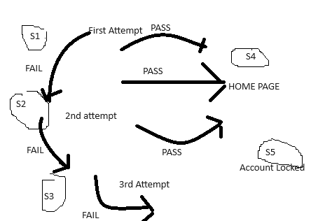
State Transition:
changes in i/p condition changes state of app under test (AUT)
Ex: Login page looks the user name after 3 wrong attempts of pw
State | Login | Correct PW | Incorrect
S1 | 1st | S4 | s2
S2 | 2nd | S4 | s3
S3 | 3rd | S4 | s5
S4 | Home
s5 | Account Lock
Error Guessing:
Thought process
Used to find bugs based on testers prior experience
Ex: Submitting form without entering value
Entering numeric in place of text

Slide 26
STLC
Requirement Analysis
Test Planning
Test case Development
Environment Set
Test Execution
Test cycle closure

Slide 27
Subset of SDLC
Refers to a sequence of specific activities conducted during the testing process to ensure software quality.
Requirement Analysis :
Objective: Understand and analyze the testing requirements based on the project specifications.
Activities: Identify what needs to be tested, determine the types of tests to perform, and define testable req.
Entry Criteria: | Exit Criteria
Availability of the requirements document (e.g., Software Requirement Specification). | Identified and documented testable requirements
Understanding of the project's business needs and objectives. | Requirements traceability matrix (RTM) is created.
Clear and complete requirements. | Test environment details are identified.

Slide 28
Test Planning :
Objective: Develop a plan for the testing process.
Activities: Create a test plan, define the scope, objectives, resources, schedule, and environment, and determine the roles and responsibilities.
Entry Criteria | Exit Criteria
Approved requirement analysis documents. | Test plan document is created and approved
Availability of the RTM | Test strategy is defined.
Initial risk assessment is completed | Effort estimation and scheduling are done

Slide 29
Test case Development:
Objective: Write detailed test cases based on the requirements.
Activities: Develop test cases, prepare test data, and prioritize tests. Ensure that the test cases cover all the functional and non-functional requirements.
Entry Criteria | Exit Criteria
Approved test plan document | Test cases are written, reviewed, and approved
Clear and detailed test requirements | Test data is prepared and validated
 | Test cases are mapped to requirements in the RTM

Slide 30
Environment Set :
Objective: Set up the environment where testing will take place.
Activities: Prepare hardware and software resources, configure the environment, and install necessary tools. Ensure that the environment mimics the production setting.
Entry Criteria | Exit Criteria
Test environment setup plan is ready | Test environment is configured and ready.
Necessary hardware and software resources are available | Environment is validated and meets the requirements
Test data is prepared | Test environment is stable and accessible

Slide 31
Test Execution :
Objective: Execute the test cases and identify defects.
Activities: Run the tests according to the plan, record the outcomes, and log defects if any issues are found. Compare actual results with expected outcomes.
Entry Criteria | Exit Criteria
Test cases and test data are ready | All planned test cases are executed
Test environment is set up and validated | All defects are logged and reported
Test plan and test cases are approved | Test execution results are documented
 | Retesting and regression testing are completed

Slide 32
Test Cycle closure :
Objective: Conclude the testing process and ensure everything is in order.
Activities: Analyze test results, document the testing process, prepare test closure reports, and confirm that all test cases are executed. Review and evaluate the testing process for future improvements.
Entry and exit criteria help ensure that each phase of the STLC is completed properly before moving on to the next, improving the overall quality of the testing process.
Entry Criteria | Exit Criteria
Completion of test execution | Test closure report is prepared and approved
All defects are either resolved or deferred | Lessons learned and process improvement suggestions are documented
Test summary reports are prepared | Test artifacts (test cases, test scripts, etc.) are archived for future use
 | Test metrics and reports are finalized and distributed to stakeholders

Slide 33
Defect Management life cycle
No Valid Yes No Fail No Yes yes PASS
Tester find bug
Dev starts fixing bug
Open
Status New
Dev fixed bug
Assigned
Dev, proj manager analysis the bug
Fixed
Existing
Deployed
retest the defect
Status Rejected
Status duplicate
Deferred
Closed
Regression

Slide 34
Stages of the Defect Life Cycle:
New:
When a defect is first found and logged by a tester, it is assigned a status of "New."
At this stage, the defect is yet to be reviewed or assigned.
Assigned:
The defect is assigned to a developer or a development team by the lead or manager for further analysis.
The developer will then take ownership of the defect.
Open:
The developer begins analyzing the defect to determine the root cause and how it can be fixed.
If the defect is valid, it remains open for fixing. If it is not valid, it may be moved to a different status such as "Rejected" or "Deferred."
Fixed:
Once the developer has made the necessary code changes to resolve the defect, its status is changed to "Fixed."
The defect is then passed back to the testing team for verification.

Slide 35
Retest:
The testing team retests the application to verify that the defect has been successfully fixed.
This involves running the same test case that originally identified the defect.
has been resolved and the testing process for that defect is complete.
Closed:
After successful verification, the tester changes the status of the defect to "Closed."
This indicates that the defect
Reopened:
If the defect persists after it was marked as fixed, or if the fix introduces another issue, the defect is "Reopened."
The cycle then starts again from the "Assigned" or "Open" stage.
Deferred:
In some cases, a defect might not be immediately fixed due to reasons such as low priority, lack of time, or resource constraints.
The defect is deferred for future release, and its status is marked as "Deferred."
Rejected:
If the developer or the testing team determines that the defect is not valid (e.g., due to a misunderstanding of requirements or not being reproducible), it is marked as "Rejected."
This status indicates that no further action will be taken on this defect.

Slide 36
Test Documents
Test Scenarios: What to be tested
Validate interface of notepad
Test case: How to be tested
Step by step action to be performed to validate functionality
Test Suite : Group of test cases (Automation)
RTM (Requirement traceability matrix) : it is used trace the requirement.
Tester will create while creating TC
Req no | Req des | testcaseID | Status
123 | Login to app | TC01 | TC01 pass

Slide 37
Priority can be changed by PO/BA/Manager but severity cant be
Severity | Priority
seriousness of bug and how much impact on business workflow(tester give this) | Importance given on bug fix (Developer give this)
Blocker: Nothing can process further (Show stopper) Ex: Login not working Critical : Main/basic function is not working Ex: fund transfer not working in net banking Major: Cause some undesirable behaviour but feature /app still functioning Ex: after booking cab no confirmation Minor: It wont cause any major breakdown of sys Ex: look and feel issue, spelling, alignments | PO(HIGH) : Defect must be resolved immediately P1(Medium): it can wait until a new version/build is created. P2(Low): developer can fix with it in later release.

Slide 38
Low priority – low severity : Spelling mistake in a page not frequently navigated by user.
Low Priority – High severity : Application crashing in some very corner case
High Priority – Low severity: Slight change in logo colour/ spelling mistake in company name.
High Priority – High Severity: Issue with login functionality
High Severity – Low priority: Web page not found when user clicked on link.

Slide 39
Test Scenario template
 |  | Req ID : When we have SRS any document use that ID
Test Scenario | Req ID | test Scenario description _v1
TS_01 | 1 | Validate the functionality of the "login/register" module
TS_02 | 2 | Validate interface of "Dashboard" module
TS_03 | 1.2 | Validate interface of "Login/ register " page
Project Name: Testing | Test Designed By: ABC
Module name: Login | Test Designed Date : 23-8-2024
Release version: v1.1 | Test Executed By - xyz
 | Test Execution Date - 24-08-2024
Req_No | Test Case# | Test Title | Test Steps | Pre Condition | Test Data | Expected Result | Post condition | Actual Result | Status | Severity

Slide 40
Req no: based on SRS we can ignore
Test_Case#: No Given for particular Test case TC_001
Test_Title : ( what u r testing) – Validate login functionality
Test_Step: :Describe steps to be tested
(Step1:EnterURL , Step2: Click)
Pre- Condition: It’s a criteria that need to be checked before test execution (Its not for all) if user registered then login
Test_Data:Data used for test executuion
Expected_Result: the result which we are expecting according to steps.
Post_condition:the message which we expect after successful run of test case
*****till here we do initially later while execting we will fill actual result
Actual_result:result occurred during execution
Status: pass/fail
Severity: the impacted of the bug

Slide 41
Module name: Help | Test Designed Date : 23-8-2024
Release version: v1.0 | Test Executed By - Vinod G
 | Test Execution Date - 24-08-2024
 |  |  |  |  |  |  |  | Test Exection time
Req_No | Test Case# | Test Title | Test Steps | Pre Condition | Test Data | Expected Result | Post condition | Actual Result | Status | Severity
 | TC_01 | Interface of help module | Step1:Enter the Url Ste2: Click on Help button | NA | NA | Step1 Should land on Home page Step2: Should land on help page | Small window requesting for login | Step1: Landed on home page Step2: Landed on Help page | PASS
 | TC_02 | Functionality of home page | Step1: Enter URL Step2: Enter FROM, TO and Date Step3: Pick date from date picker Step4: Click on search button | Buses should be listed and date should be same day/ahead | KSRTC Bus Mysore to Bangalre | Step1 Should land on Home page Step2: Should have valid entry Step3: Date should be selected Step4: Should display list of buses with schdule | NA | Step1: Landed on homepage Step2: Accepted entries Step3:Date is selected Step4:Result displyed | PASS

Slide 42
RTM (Requirement )
It is used to trace the req and get to know the status
Requirement Tractability Matrix
Project name | ABC
Reviwer/Approver | Manager
Req no | Req Des | test case ID | Status
1 | Validate Redbus Help | TC01, TC02, TC-03, TC-04 | TC-01- PASS TC-02-PASS TC-03- No run TC-04-FAIL

Slide 43
Test Plan
Introduction
Test Strategy
Test Objective
A production sw ready
A set of stable script
Test Assumptions
Key assumptions , what all we do what we cant do
General
Function testing and performing yavd madbeku anta
Test Principle:
Scope and level of testing
Exploratory
Functional
Test Acceptance criteria
Test exit criteria
Test Cycle
Test matrix (%), yen progress
Defect tracing and reporting

Slide 44
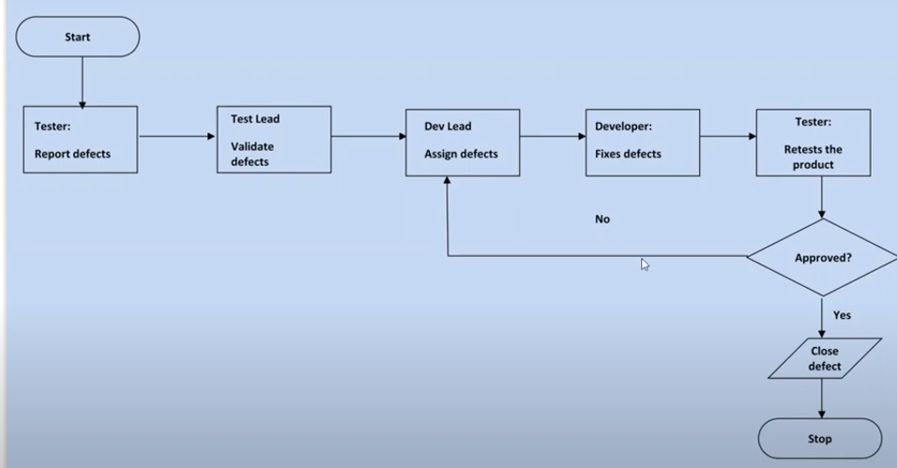
Defect Tracking report

Slide 45
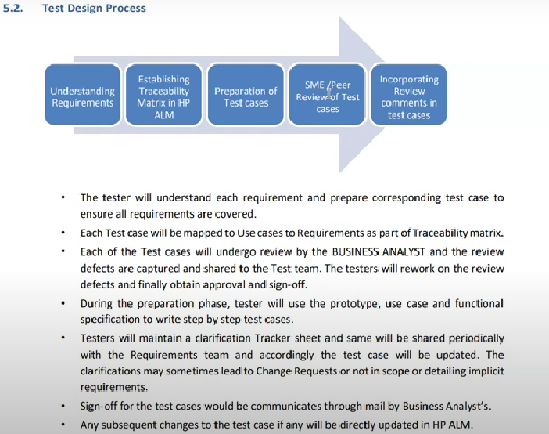

Slide 46
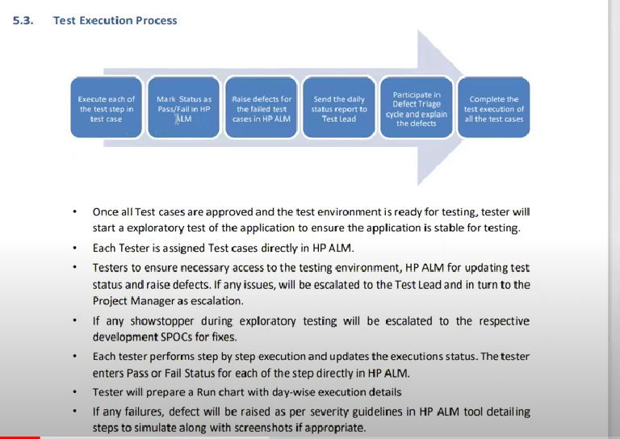

Slide 47
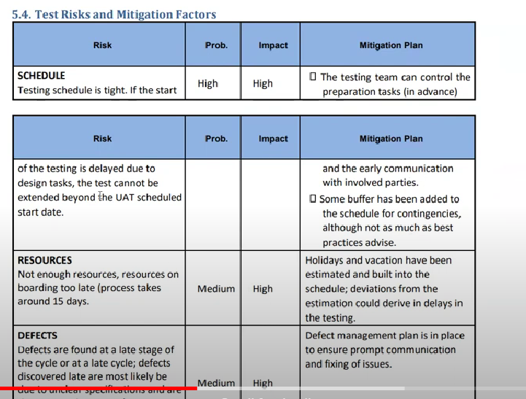

Slide 48
Agile Model
Its an iterative/incremental process
Advantage | Dis
Req changes are allowed at any phase of development | Less focus on design and documentation process
Release will be very fast | Hard for long term proj
Main goal customer s
Good communication b/w BA, Dev and tester
Very easy model to adopt

Slide 49
Scrum
It a process of implementing agile methodology
In scrum time divided into sprints and on completion of sprints
Roles:
PO | Scrum master | Scrum Team | Sprint Planning
Owns the whole development of product , assign task to team and at as interface b/w scrum team and stake holder | Monitor scrum rules get followed in the team and conduct scrum meetings | Participate scrum call and perform on assigned task | Dived the work palnning delivery

Slide 50
